Slide 1
Baseline Matrix Factorization Algorithm for Rating Prediction Parisa Lak
Date: April 24th 2015

Slide 2
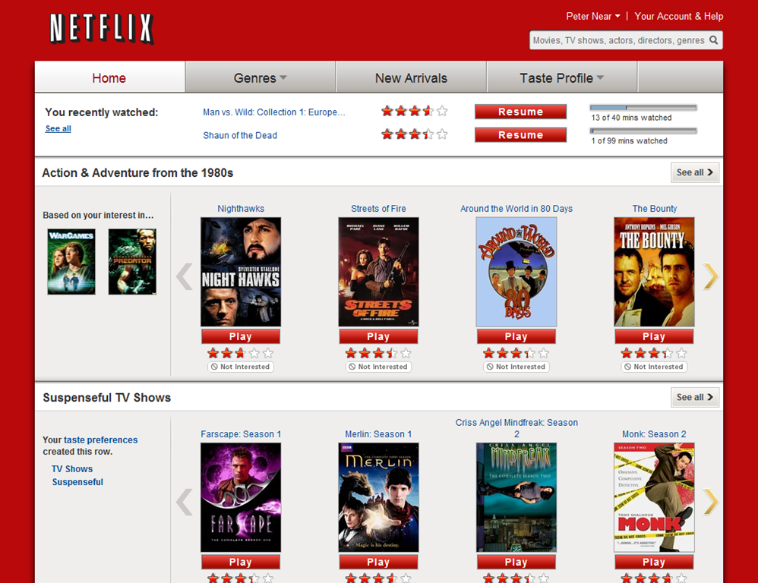

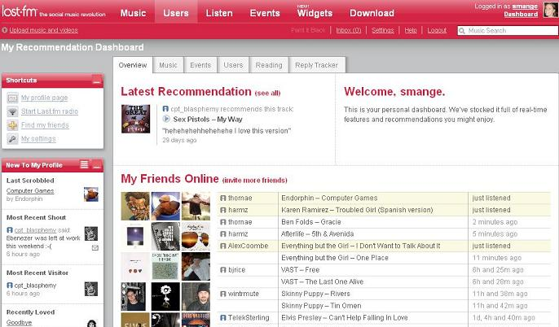
Introduction
Recommender Systems
Software tools and techniques providing users with suggestions for items a user may wish to utilize

Slide 3
Introduction
Content based Recommendation
Recommendations are based on the information from the content of an item rather than users’ opinion
Uses Machine learning algorithm to induce a profile of users’ preferences
Collaborative filtering technique
The process of filtering or evaluating items using the opinions of other people
User-User or Item-Item similarities
Notes:
Content based recommendation is based on a description of the item and a profile of the user’s preferenceTo abstract the features of the items in the system, an item presentation algorithm is applied. A widely used algorithm is the tf–idf representation (also called vector space representation).
To create user profile, the system mostly focuses on two types of information: 1. A model of the user's preference. 2. A history of the user's interaction with the recommender system
Collaborative filtering is

Slide 4
Collaborative Filtering
Neighborhood models
Item item or user user similarities
Latent Factor
Transforms both users and items into the same latent space
Characterizing both by ratings
Matrix Factorization

Slide 5
What is Matrix Factorization?
Decomposing a large matrix into two smaller one
The dot product of the two should be equal to the original matrix
4X4
4X3
3X4
52 | 32 | 44 | 89
62 | 65 | 93 | 88
64 | 56 | 92 | 88
60 | 68 | 85 | 92
0 | 8 | 5
9 | 5 | 6
8 | 4 | 8
8 | 7 | 4
2 | 5 | 6 | 2
4 | 4 | 3 | 8
4 | 0 | 4 | 5

Slide 6
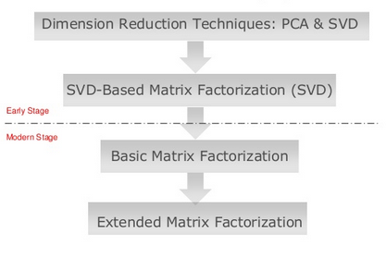
Matrix Factorization in Recommender Systems
The Evolution of MF in Recommender systems

Slide 7
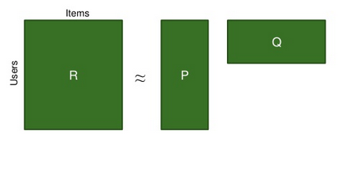
Matrix Factorization
Users | Spiderman | Limitless | Inception
U1 | 5 | 4 | 3
U2 | ? | 2 | 5
U3 | 5 | 5 | ?
n
n items
f
m users
m
R_{ui} = q_{i}^{T}. p_{u}
f

Slide 8
Matrix Factorization
P_{u} indicates how much user u likes f latent factors
Q_{i} shows how much item i obtains f factors
R_{ui} shows how much user u likes item i
The latent factors can be genre of movie such as romance, action, horror, adventure, comic, etc.
n
n items
f
m users
m
R_{ui} = q_{i}^{T}. p_{u}
f

Slide 9
Optimizing Factors
To find the best feature matrix that explains users (P) and items (Q) we should perform optimization
min Σ (r_{ui} - q_{i}^{T}p_{u})²
min Σ (r_{ui} q_{i}^{T}p_{u})²+ λ((||q_{i}||² + ||p_{u}||²)
The cost function in our optimization problem
Regularized item is added to avoid over-fitting

Slide 10
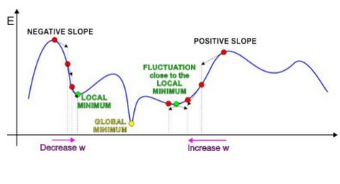
Optimizing Factors
Optimization is performed using Stochastic Gradient Descent (SGD)

Slide 11
Optimizing Factors
First initialize both user and item matrices with a small random number
To modify the user and item matrices we first calculate the error from actual rating and the dot product of the P and Q matrices (predicted rating)
e_{ui} = r_{ui} – q_{i}^{T}p_{u}
It modifies parameters of p and q by a magnitude proportional to a predefined learning rate (γ) in the opposite direction of the gradient
q_{i} ← q_{i} + γ (e_{ui} * p_{u} – λ * q_{i} )
p_{u} ← p_{u} + γ (e_{ui} *q_{i} - λ * p_{u} )

Slide 12
Example
Users | Spiderman | Limitless | Inception
U1 | 5 | 4 | 3
U2 | ? | 2 | 5
U3 | 5 | 5 | ?
1. Initialize P and Q matrices
User | f1 | f2 | f3 | f4
U1 | 0.003 | 0.003 | 0.003 | 0.003
U2 | 0.003 | 0.003 | 0.003 | 0.003
U3 | 0.003 | 0.003 | 0.003 | 0.003
Movie | Spiderman | Limitless | Inception
f1 | 0.003 | 0.003 | 0.003
f2 | 0.003 | 0.003 | 0.003
f3 | 0.003 | 0.003 | 0.003
f4 | 0.003 | 0.003 | 0.003
2. Calculate R^_{ui} = q_{i}^{T}. p_{u}

Slide 13
Example
3. Calculate the error between predicted rating and the actual known rating
4. Refine the parameters of the matrices
5. Redo step 2-5 until convergence (or reach to the maximum number of iterations)

Slide 14
Example
Optimized Matrix:
Assume that the result is 3.203
Movie | Spiderman | Limitless | Inception
f1 | 1.553 | -0.345 | 0.772
f2 | -0.364 | 0.981 | -0.224
f3 | 0.305 | -1.345 | 1.567
f4 | 0.987 | 0.586 | -0.334
User | f1 | f2 | f3 | f4
U1 | 0.243 | 0.789 | -0.290 | -1.287
U2 | 1.543 | -0.647 | 0.834 | -0.303
U3 | 0.448 | -1.294 | -1.409 | 0.243
Users | Spiderman | Limitless | Inception
U1 | 5 | 4 | 3
U2 | ? | 2 | 5
U3 | 5 | 5 | ?

Slide 15

Accuracy Evaluation
Prediction Accuracy Evaluation
Precision Recall
Mean Absolute Error (MAE)
Root Mean Square Error (RMSE)
Notes:
But how do we evaluate accuracy? There are various techniques to evaluate the accuracy of recommendations. The most commonly used technique in the literature is RMSE

Slide 16
Root Mean Square Error (RMSE)
The lower the RMSE, the better the prediction
There is evidence that small improvements in RMSE terms can have a significant impact on the quality of the top few presented recommendations (Mehta et al. 2007)
There are several studies on extensions of MF to achieve higher accuracy

Slide 17
Extended Matrix Factorization
Adding biases to the basic algorithm
To account for personalization
b_{i} is the item bias to account for ex. popular items
b_{u} is users bias to account for ex. users who assign low rates
rˆ_{ui} = μ + b_{i} + b_{u} +q_{i}^{T}p_{u}
Global mean of all ratings
The deviation of mean of a specific user’s rating from global mean of all ratings
deviation of the mean of an item’s ratings from the mean of all available ratings

Slide 18
Extended Matrix Factorization
The system learns by minimizing the squared error factor:
min Σ (r_{ui}- μ - b_{i} - b_{u} - q_{i}^{T}p_{u})²+ λ((||q_{i}||² + ||p_{u}||²+ b_{i}² +b_{u}²)
Learning algorithms used is stochastic gradient descent loop
b_{i} ← b_{i} + γ (e_{ui} – λ * b_{i} )
b_{u} ← b_{u} + γ (e_{ui} - λ * b_{u} )
q_{i} ← q_{i} + γ (e_{ui} * p_{u} – λ * q_{i} )
p_{u} ← p_{u} + γ (e_{ui} *q_{i} - λ * p_{u} )
Notes:
The algorithm loops through all ratings in training set and calculates estimated ratings for each user-item characteristic Then, the error associated with the prediction is calculated (e_{ui}). Consequently, it modifies parameters of p and q by a magnitude proportional to a predefined learning rate in the opposite direction of the gradient. The result will be as follows

Slide 19
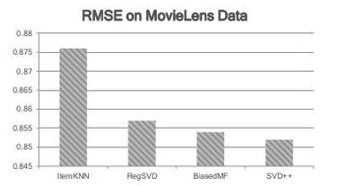
Evaluation of different RS on Movielens data
RMSE value for biasedMF is comparable to SVD++, which is a complicated algorithm
Source: Zheng et al.

Slide 20
Experiment
Movielens 1M
1,000,209 anonymous ratings
UserIDs range between 1 and 6040
MovieIDs range between 1 and 3952
Ratings are made on a 5-star scale (whole-star ratings only)
Each user has at least 20 ratings

Slide 21
Results
Matrix Factorization
RMSE = 0.8917
Time = 799.355 s
Predicted Rating
 | 1 | 2 | 3 | 4 | 5
1 | 636 | 3859 | 3947 | 1259 | 53
2 | 196 | 3892 | 10117 | 4247 | 151
3 | 98 | 2815 | 22088 | 19466 | 951
4 | 56 | 830 | 15434 | 39854 | 4615
5 | 17 | 163 | 4007 | 24760 | 10438
Actual Rating

Slide 22
Results
Extended Matrix Factorization with baseline biases
RMSE = 0.8856
Time = 825.816 s
Predicted Rating
 | 1 | 2 | 3 | 4 | 5
1 | 826 | 3833 | 3884 | 1180 | 31
2 | 237 | 4136 | 10123 | 3996 | 111
3 | 101 | 3052 | 22962 | 18659 | 644
4 | 25 | 869 | 16425 | 39979 | 3491
5 | 10 | 177 | 4202 | 26228 | 8768
Actual Rating

Slide 23
Cluster based MF
Two step algorithm
Applied Biased MF on training to find baseline matrix for user and item
Applied K-means with k=20 to find similar users
Used one single feature for all similar users, which was the mean of all the previously calculated 6 latent features
Applied Biased MF one more time on 1 feature

Slide 24
Results
Clustering based Matrix factorization
RMSE = 0.9080
Predicted Rating
 | 1 | 2 | 3 | 4 | 5
1 | 777 | 3524 | 4052 | 1361 | 40
2 | 226 | 3892 | 10066 | 4298 | 121
3 | 113 | 3165 | 22541 | 18896 | 703
4 | 29 | 988 | 17081 | 39300 | 3391
5 | 14 | 210 | 4683 | 26377 | 8101
Actual Rating

Slide 25
Next step
Change the new rating to be the mean of the ratings for all similar users and then apply the MF
Test different sizes for K, since bad clustering may reduce the accuracy

Slide 26
Questions & comments
Parisa Lak

